Slide 1

Cloud & serverless computing
PROJECT TITLE:
USING AWS –BUILDING A SERVERLESS WEB APPLICATION
GARAPATI SRINIJA
2000031388

Slide 2
overview
You can build a serverless web application by using several AWS services together. Each service is fully managed and does not require you to provision or manage servers. You only need to configure them together and upload your application code to AWS Lambda, a serverless compute service
Open-source framework for building serverless applications. It provides shorthand syntax to express functions, APIs, databases, and event source mappings. With just a few lines per resource, you can define the application you want and model it using YAML
The Wide Range of Secure & Scalable AWS Webapp Hosting Options. Sign Up Today! Explore Low-Cost Ways To Deliver Websites & Web Applications With AWS. Sign Up for Free! Services: Compute Capacity, Virtual Private Server, Automatic Distributio

Slide 3
What you will accomplish
Creating a aws cloud9 environment
Create a serverless web application
Create a aws amplify
Create a amazon Cognito
Create a amazon API gateway
Create a aws lambda

Slide 4
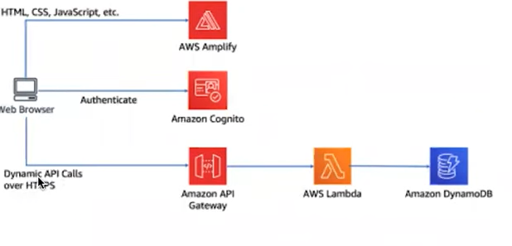
ARCHITECTURE DIAGRAM

Slide 5
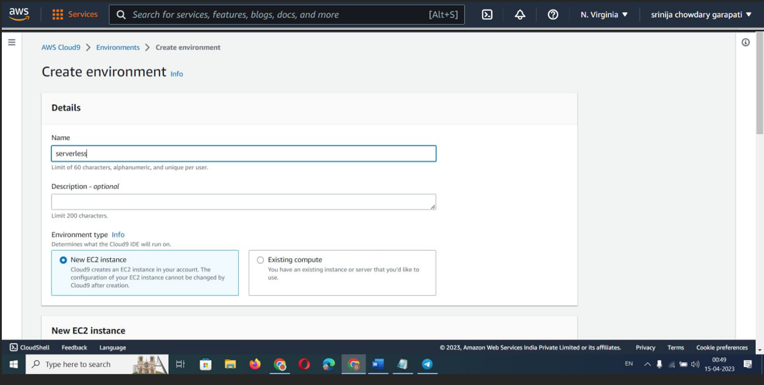
STEP-1 CREATING CLOUD9

Slide 6
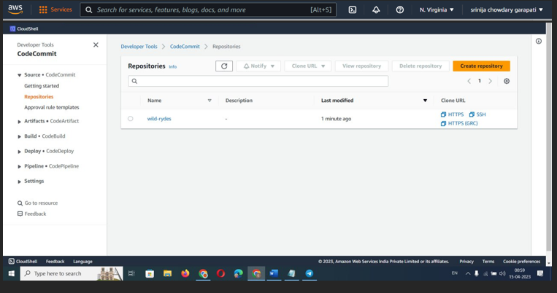
Step-2 Creating a repository in a CodeCommit

Slide 7
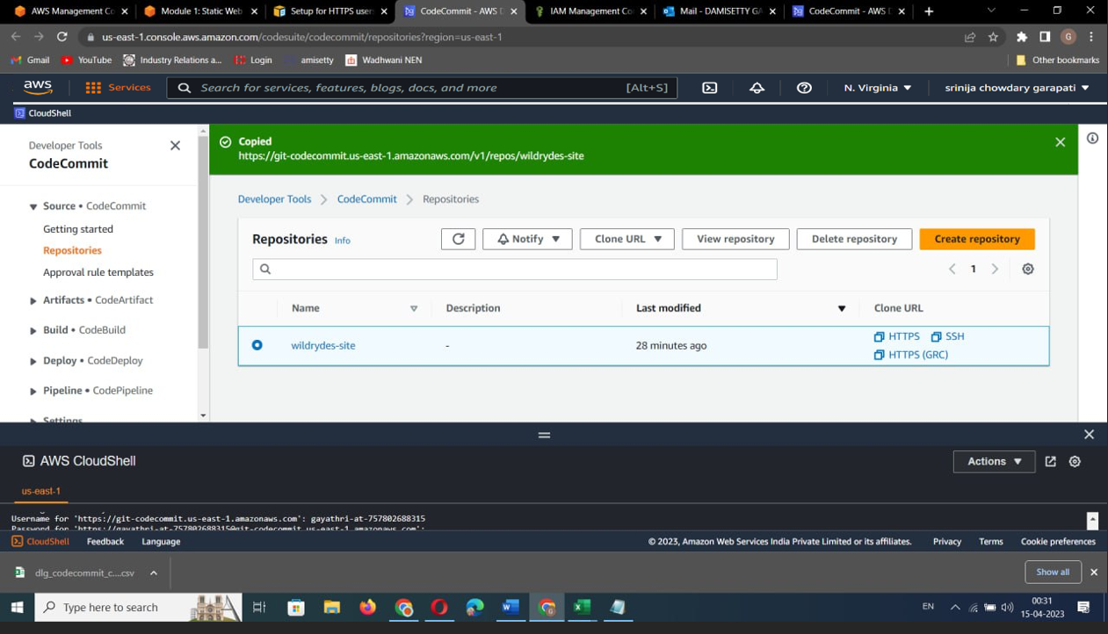

Slide 8
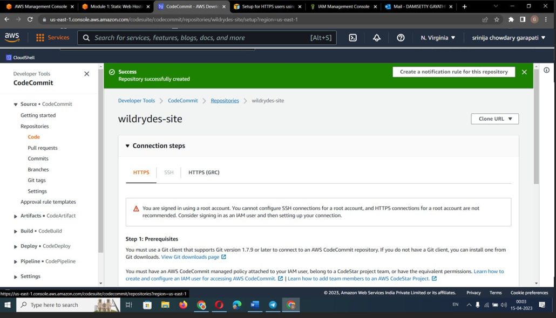
Step3:successfully repository created

Slide 9
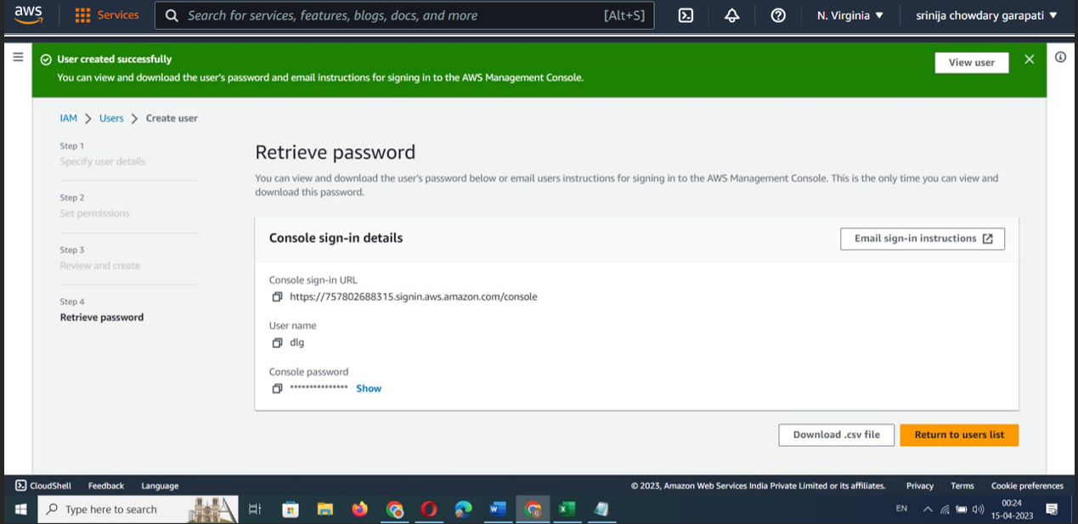
Step4-IAM user is created

Slide 10
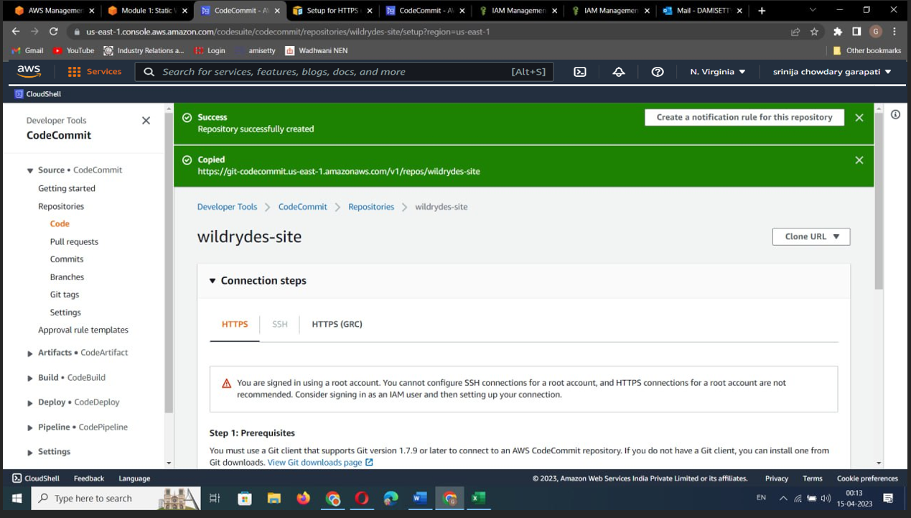
STEP-5 Create a Cloud9 environment: In the AWS Management Console

Slide 11
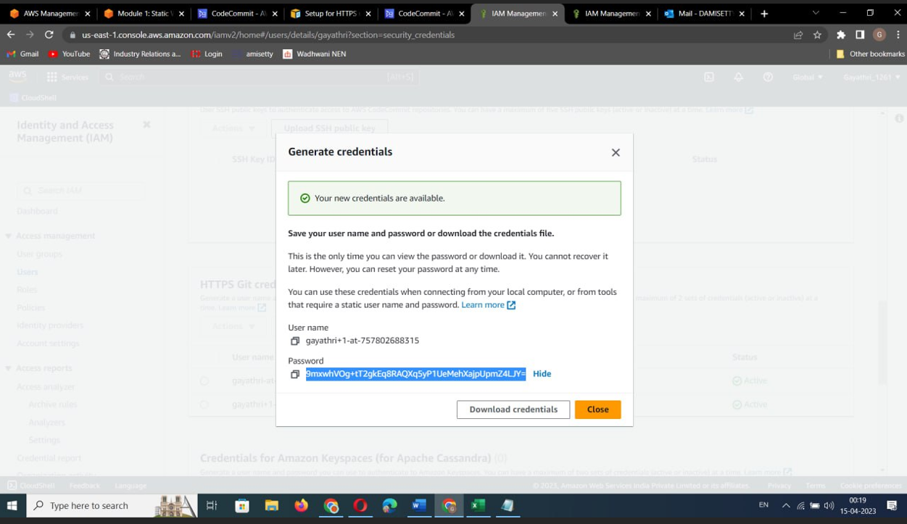
STEP-6 Create a DynamoDB table: Create a DynamoDB table to store data for your application.

Slide 12
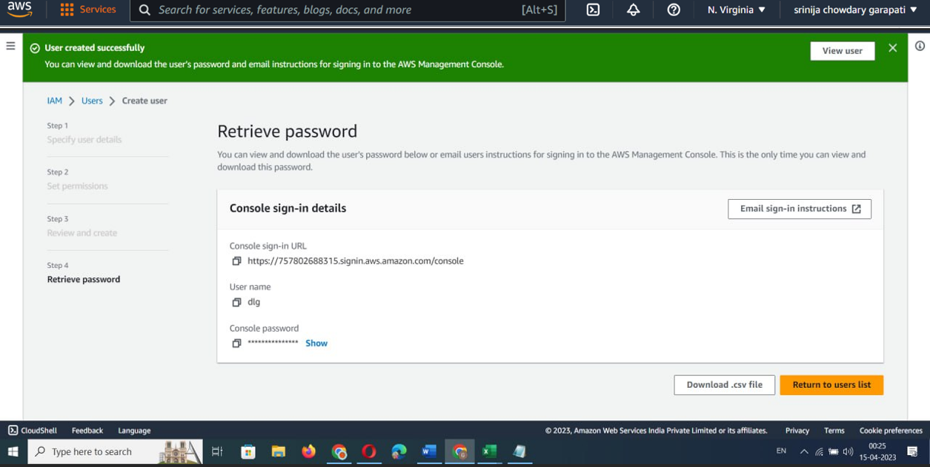
STEP -7 Integrate API Gateway with Amplify: Connect your API Gateway APIs to your Amplify app.

Slide 13
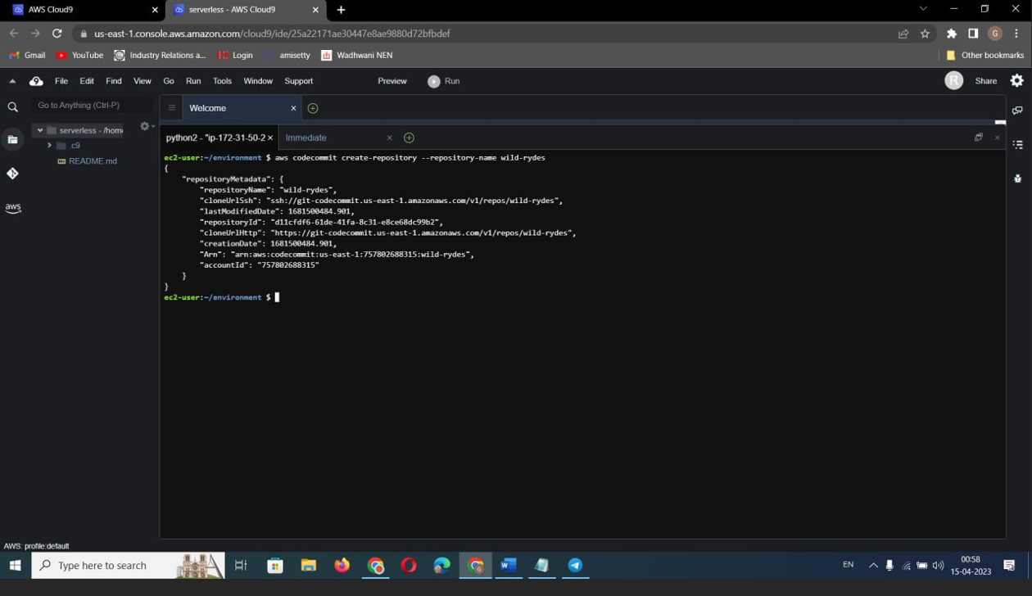

Slide 14


Slide 15
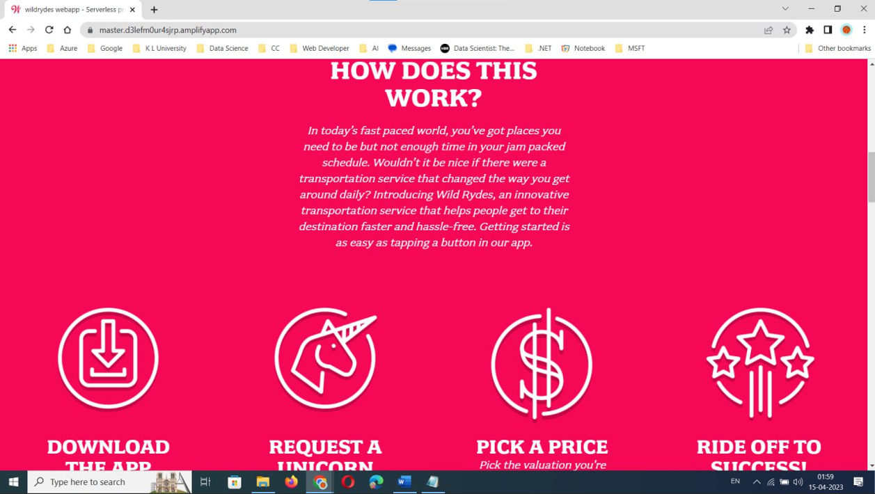

Slide 16
CONCLUSION
In conclusion, creating a serverless static web hosting in AWS using Cloud9, Amplify, CodeCommit, API Gateway, and DynamoDB offers a scalable, cost-effective, and efficient solution for hosting a website or web application. With these tools, you can easily set up a development environment, create and store your code in a secure repository, deploy your application using the Amplify CLI, and integrate it with API Gateway and DynamoDB to enable dynamic functionality. Moreover, the pay-per-use pricing model of these services allows you to only pay for the resources you use, which makes it an ideal choice for startups, small businesses, or anyone looking to host a website without incurring a lot of infrastructure costs. Overall, the combination of these AWS services offers a reliable, flexible, and easy-to-use solution for hosting a static website or web application in a serverless environment.

